Slide 1
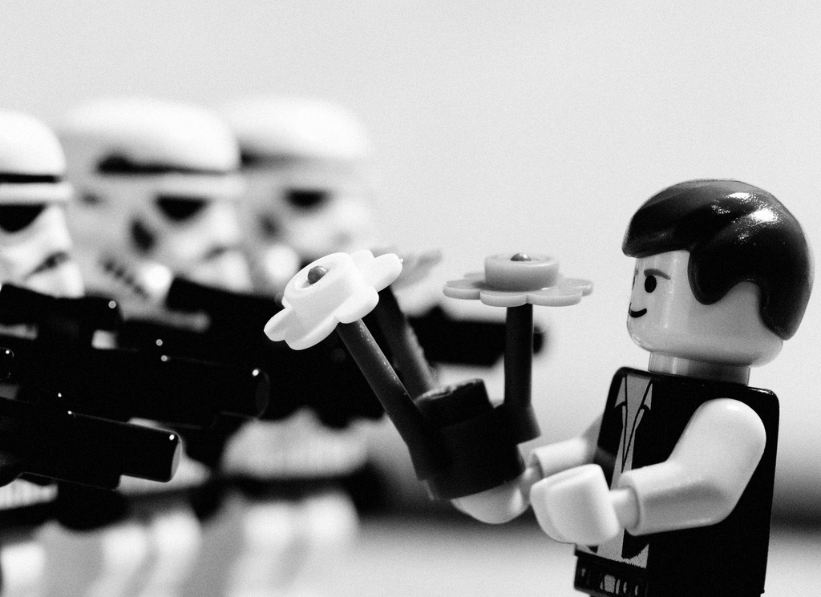
Method III Conflict Resolution

Slide 2
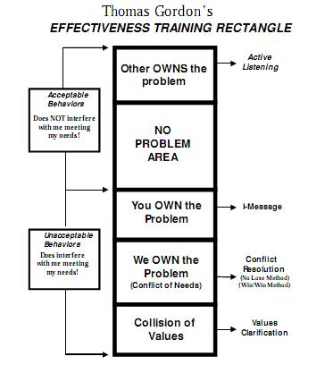

Slide 3
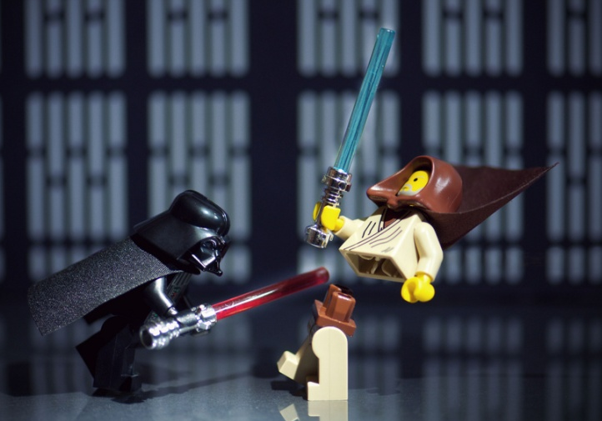
Method III Conflict Resolution allows us to find a solution where no-one has to lose.
It’s a win-win result.

Slide 4

Six Steps
Define the problem.
Brainstorm possible solutions.
Evaluate solutions – does it meet both people’s needs?
Choose a solution.
Implement your chosen solution.
Monitor the solution and evaluate success.

